Slide 1
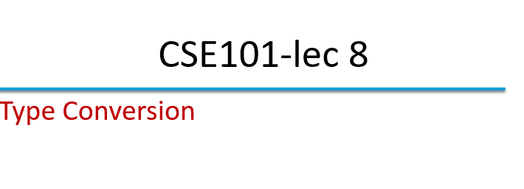

Slide 2
Type Conversion
C evaluates arithmetic expressions only in which the data types of the operands are identical.
To ensure that operands are of same type the compiler performs type conversion.
Converting between types can be :
  Implicitly (automatically)
  Explicitly (forced)

Slide 3
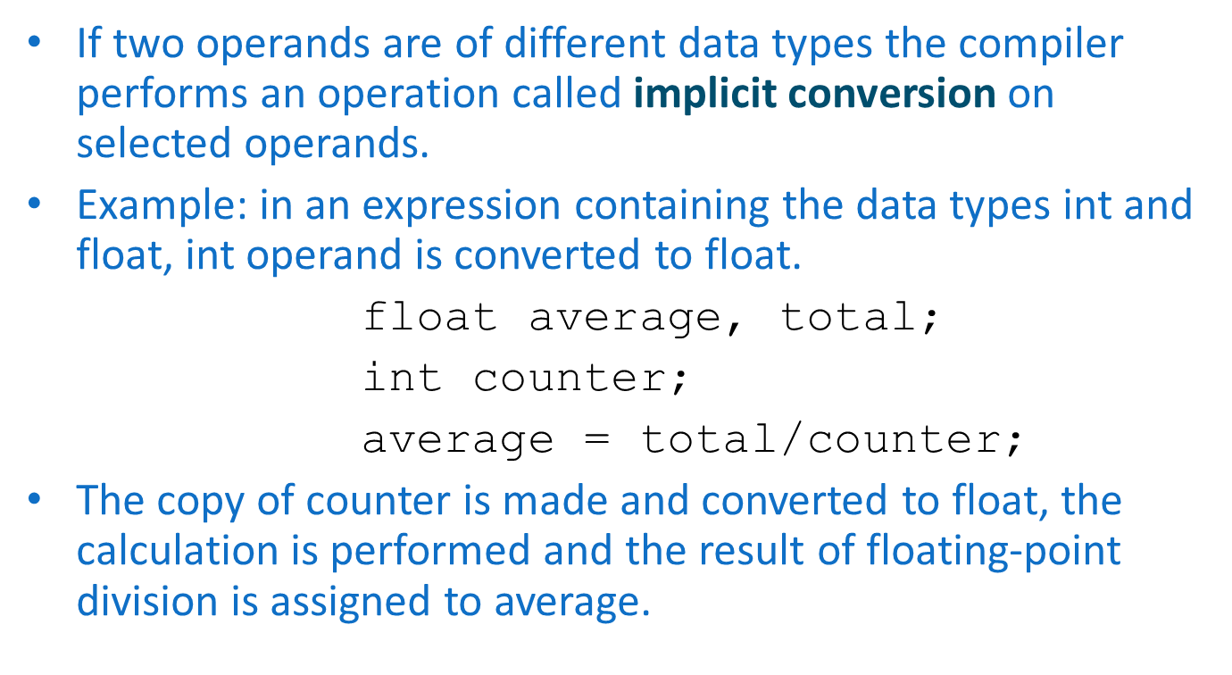
Implicit Conversion

Slide 4
Explicit Conversion
Type is converted using unary type cast operator.
Which temporary converts the operands.
Example: in an expression containing the data types int and float, int operand is converted to float.
      float average, total;
      int counter;
      average = total/(float)counter;
The temporary floating-point copy of counter is created. The value stored in counter is still integer.
calculation is performed and the result of floating-point division is assigned to average.

Slide 5
Cast operator is unary operator i.e. it takes only one operand.
It is formed by placing parentheses around the type name with operand.
Syntax
(type) operand;

Slide 6
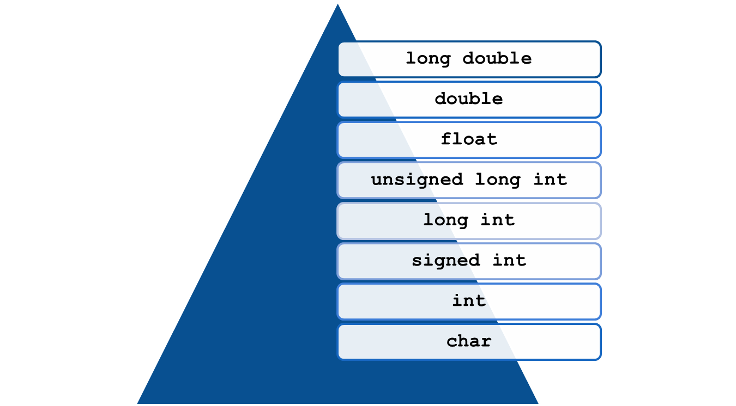
Type Modifiers

Slide 7
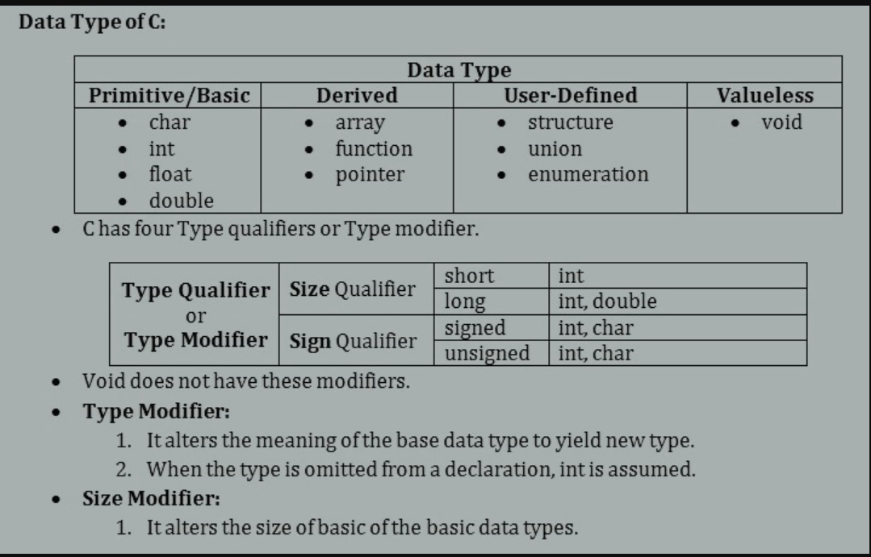

Slide 8
#include<stdio.h>
int main()
{ int x = 10;
char y = 'a';
x = x + y;
float z = x + 1.0;
printf("x = %d, z = %f", x, z); return 0;
}
A. x = 107, z = 108.00
B. x = 107, z = 108.0000
C. x = 107, z = 108.000000
D. x = 108, z = 108.000000

Slide 9
#include<stdio.h>
int main()
{
double x = 1.2;
int sum = (int)x + 1;
printf("sum = %d", sum);
return 0;
}
A. sum = 2
B. sum = 1
C. sum = 0
D. sum = 3

Slide 10
What will be the data type of the result of the following operation?
(float)a * (int)b / (long)c * (double)d
a) int
b) long
c) float
d) double

